Slide 1
41183 PRIVACY PRESERVING
Lecture 9. Federated Learning and Secure Data Aggregation

Slide 2
Outline
Federated learning background
Attacks on federated learning
Secure data aggregation

Slide 3
Federated Learning background

Slide 4
Data for learning
Data is the oil the for AI
Datasets are collected for machine learning processes.
Then data owners have a serious concern
How my data will be protected from potential attacks
Will my data be used as the data curator promised
The data curator may sell my data to other parties
…
In other words, we do NOT trust the data curators !

Slide 5
Federated learning
the strategy – opposite thinking
- Do not ask participants to share their data
- Move the training model to the participants

Slide 6
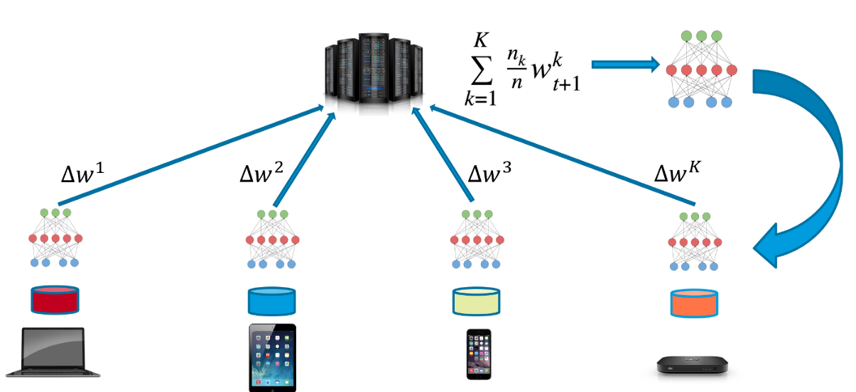
Federated learning framework
(diagram from the Internet)

Slide 7
Federated learning workflow
0. Workers (data owners) keep their data locally
1. Workers firstly download a learning model (aka an executable program)
2. Workers execute the learning on their local devices, respectively.
3. The trained local model or parameters (e.g., gradients) will be uploaded to the central server
4. The server will aggregate the received parameters, and broadcast the new parameters to the workers
5. The workers start another round of learning …
6. Stop when the trained model converges.

Slide 8
Federated learning statistics
Total population size: 10⁶ – 10¹⁰ devices
Selected devices each round: 50 – 5000
Total devices participate in one learning task: 10⁵ –10⁷ devices
Number of rounds for convergence: 500 - 10000
Wall-Clock training time: 1 – 10 days

Slide 9
Attacks on Federated Learning

Slide 10
Attacks on federated learning
Old attacks + new invented attacks (for financial, political reward, …)
Inference attack (the model has been trained, and deployed in practice)
Poisoning attack (during the model training stage) (next week)
…

Slide 11
Inference Attacks
Inference attacks:
obtain the unknown (interested information) from known (the available model, background knowledge, etc.)
- Is Bob’s medical data in the cancer training dataset of a cancer prediction model?
The attackers could be at the server side (honest but curious) or someone monitoring the network traffic of the victim

Slide 12
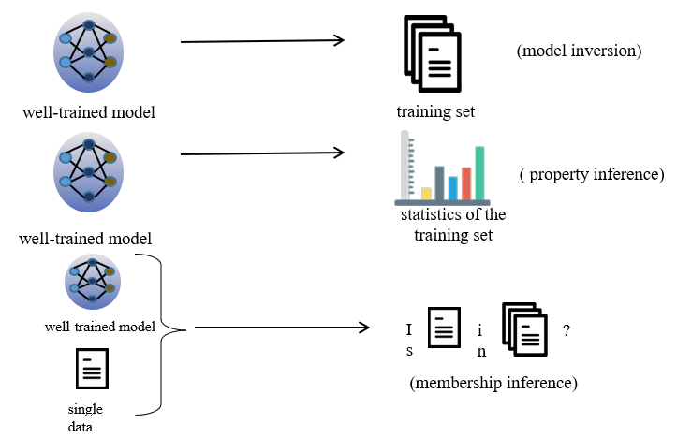
Different inference attacks

Slide 13
Counter Inference Attacks
Differential privacy
- add DP noise to each round of learning
- add DP noise to the last round of learning
2. Using cryptographic tools,
e.g. multiple part computing (MPC)

Slide 14
Secure data aggregation in federated learning

Slide 15
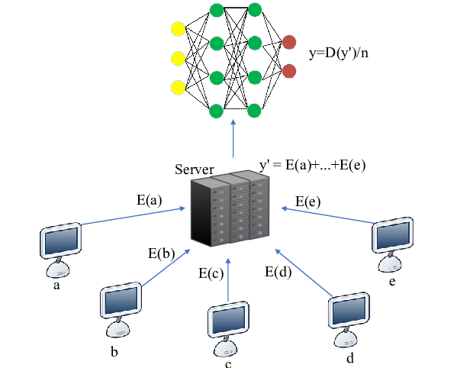
Homomorphic encryption (hide the parameters)
 Each user transfers the encrypted local gradient to FL server
FL server directly
calculates the encrypted ciphertext to get the average gradient
● The FL server transmits the updated gradient to each data owner

Slide 16
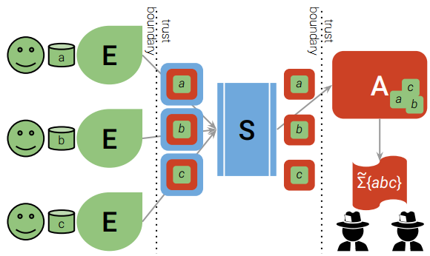
Shuffle model (hide the IDs)

Slide 17
Encode-Shuffle-Analyze (ESA) model
Lightly “encrypted” for information aggregation
add random noise between –t and +t for each client, the noise will cancel each other in the final aggregation
Organize pairs to cancel each other in the aggregation. E.g., m1 + X and m2- X for the pair client 1 and 2

Slide 18
Multiple server data aggregation
There are k servers to cooperate for data aggregation.
An encoder separates each uploaded data into k components, and upload them to k servers, respectively.
The k servers execute aggregation to obtain the intended result.

Slide 19

References
Chapter 1 for federated learning
Chapter 2 for reference attacks.
Chapter 7 for secure data aggregation

